Slide 1


Vehicle Service Centre Management

Slide 2
STEPS INVOLVED :
1.One company has many branches. Each branch belongs to one company(1:N)
2.One branch employs many employees. Each employee works at one branch(1:N))
3.Customers are typically linked to branches. (N:1)
4.One customer can own multiple vehicles. Each vehicle belongs to one customer(1:N)
5.Each branch manages one inventory(1:1)
6.One inventory item can be used in many services.(1:N)
7.Many services can be handled by one employee, but each service is handled by one employee(N:1)
8.Each vehicle undergoes 1 service at a time (1:1)
9.Each service generates one billing record(1:1)

Slide 3






Name
Phone_no
Company_ID
COMPANY
Address
E_Mail
1
Has
Manager
Branch_ID
N
Active_hours
Company_ID
BRANCHES
Phone_No
Address
E_Mail
1
1
1
Role_ID
Employs
Has
Name
Has
N
Emp_ID
Inventory_ID
N
Customer_ID
1
Address
1
Phone_No
EMPLOYEE
INVENTORY
Parts_ID
CUSTOMER
Phone_No
1
Branch_ID
Branch_ID
1
Parts
Avilability
1
Branch_ID
Date Of Joining
E_Mail
Has
Experience
Consumes
Vehicle_ID
N
Vehicle_ID
VEHICLES
Customer_ID
Pays
Service_ID
Type
Part_ID
N
1
Emp_ID
Undergoes
Provides
SERVICE
N
1
Total_Amount
1
Bill_ID
Needs
Transaction
Mode
1
Service_ID
BILLING
Date-Time
1

Slide 4
Database schemas:
%
Company,Branches,Employee,Inventory,Customer,
Vehicle,Service,Billing
Business
Graphic

Slide 5
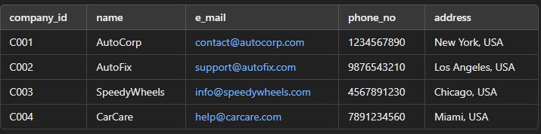
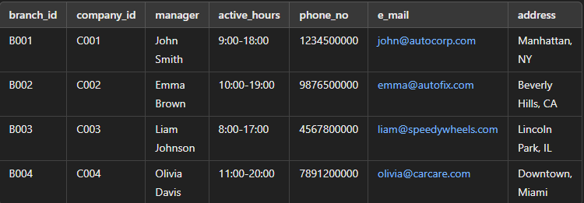


Relational schemas:
Company-company_id, name, e_mail, phone_no, address
branches-branch_id, company_id, manager, active_hours, phone_no,e_mail,address

Slide 6
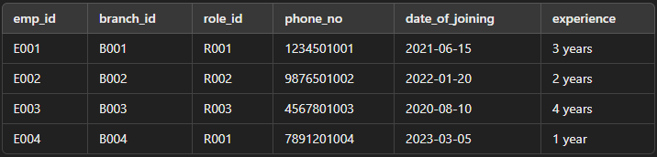

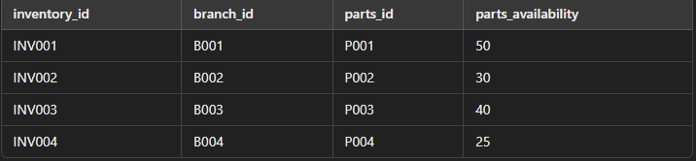

employees-emp_id, branch_id, role_id, phone_no,date_of_joining,experience
inventory-inventory_id, branch_id, parts_id, parts_availability

Slide 7
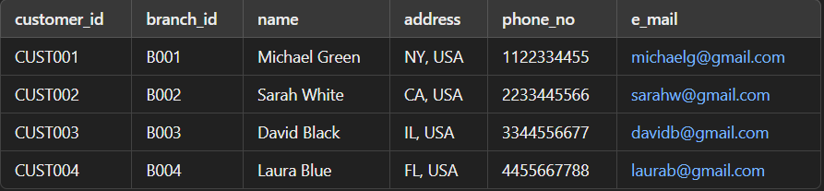
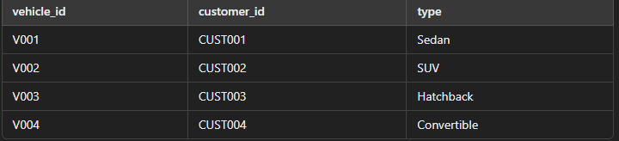
customer- Customer_ID, branch_id, Name, Address, Phone_No, E_Mail
vehicle - vehicle_id, customer_id, type

Slide 8
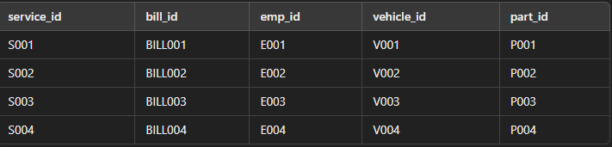
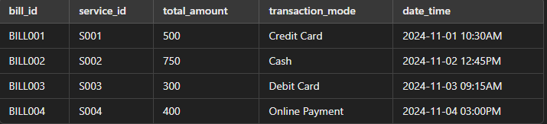
service- service_id, emp_id, vehicle_id, part_id
billing- bill_id, service_id, total_amount, transaction_mode, date_time

Slide 9


Thank you!
PRESENTED BY:
Jothikumar G
Chandru T
Nishanth Sanjay N

